Slide 1


Slide 2
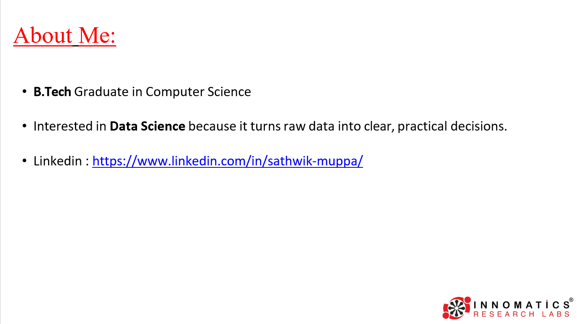

Slide 3
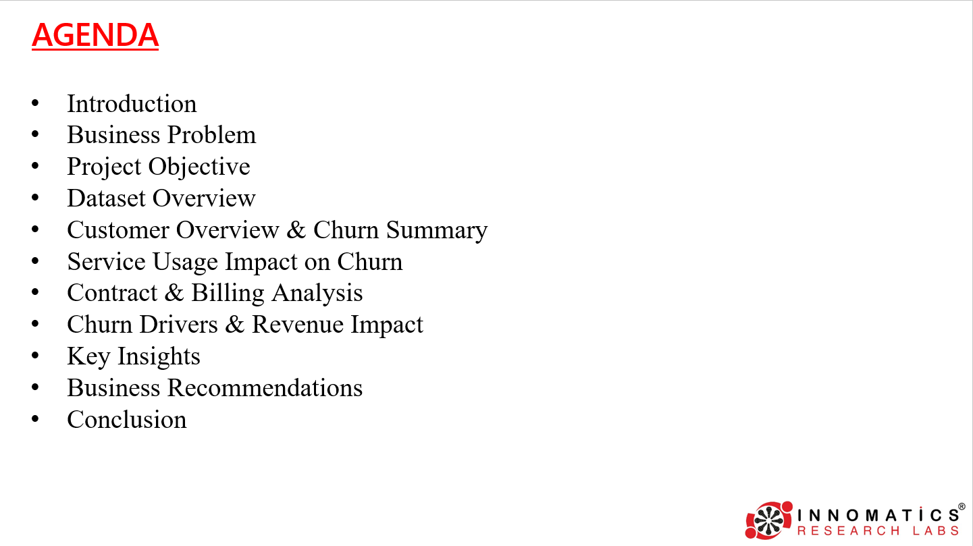

Slide 4

Introduction
Telco Customer Churn Analysis
• Customer churn refers to customers discontinuing services with a company.
• Churn is a major challenge in the highly competitive telecom industry
• Even a small increase in churn can lead to significant revenue loss
• Understanding churn helps companies retain customers and stabilize revenue
This project analyzes:
  Customer behavior
  Service usage Patterns
  Contract and Billing Details

Slide 5

Business Problem
  Telecom companies are facing declining revenue stability due to increasing customer attrition, directly impacting profitability and long-term growth.
  High customer churn is causing loss of recurring revenue and reduced customer lifetime value, making it difficult for businesses to sustain predictable income.
  Businesses lack clear visibility into which customers are churning and the factors driving churn.
  Without this visibility, organizations are unable to identify high-risk customers early, evaluate the impact of churn on revenue, and design effective data-driven retention strategies.

Slide 6
Objective
  To analyze customer churn patterns across different customer segments.
  To identify key factors influencing churn, such as contract type, tenure, services, and billing methods.
  To measure the impact of churn on revenue and customer retention.
  To build an interactive churn analysis dashboard using Power BI for business users.
  To support data-driven decision making by providing actionable insights to reduce churn.

Slide 7
Dataset Overview
The dataset represents telecom customer data with churn outcomes.
Each row corresponds to a unique customer.
The dataset includes:
  Demographic details (gender, senior citizen, dependents)
  Service subscriptions (internet, phone, add-ons)
  Billing and contract information
  Churn indicator (Yes / No)
7,043 customers with active and churned status
Churn identified as the target variable

Slide 8
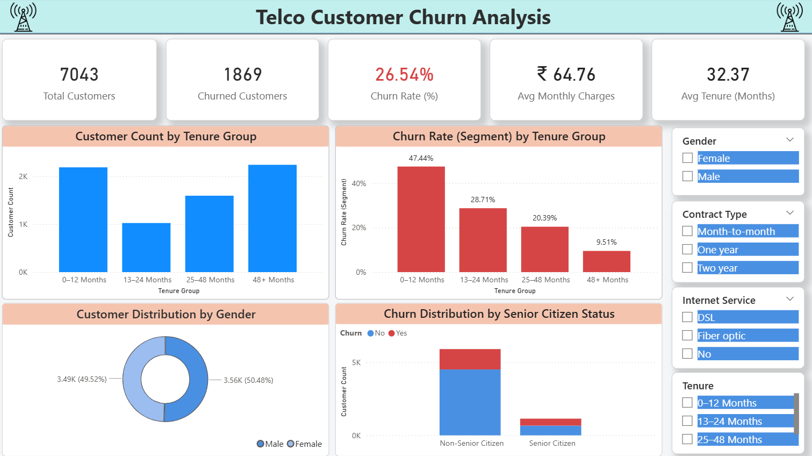

Slide 9
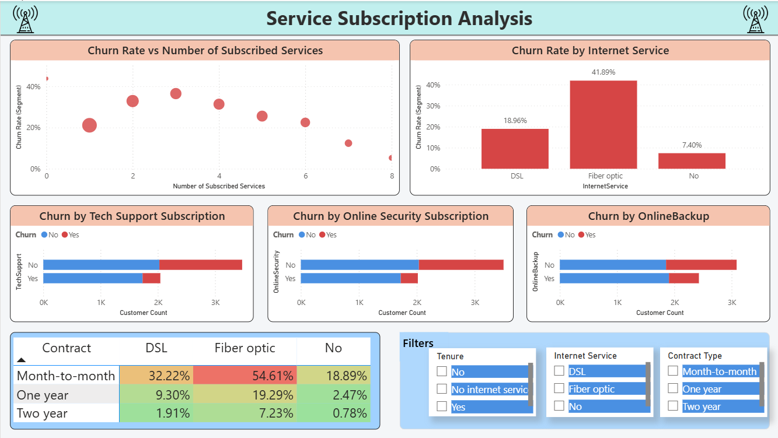

Slide 10
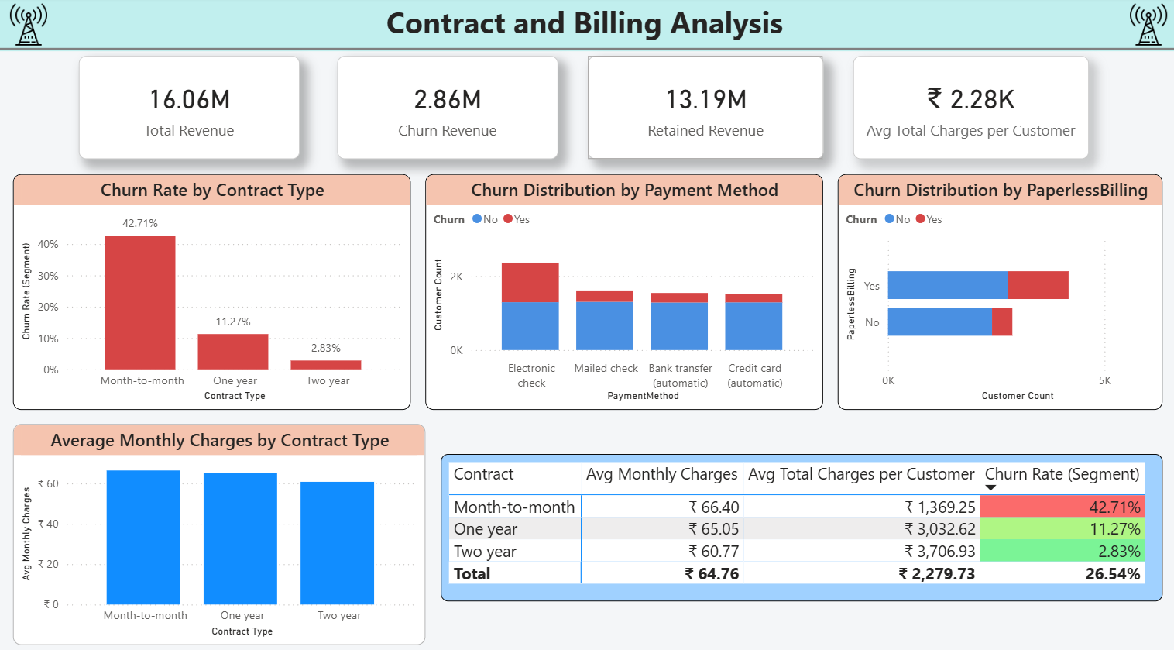

Slide 11
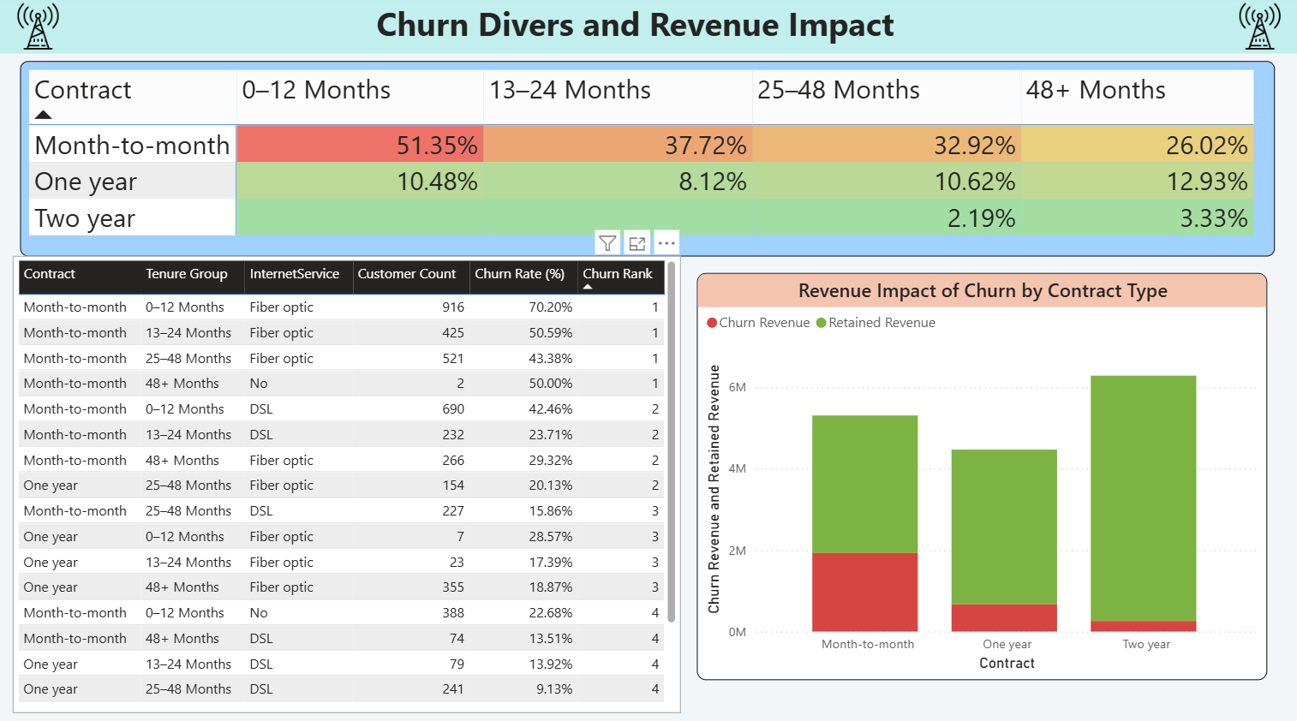

Slide 12
Key Insights
Customer Overview & Churn Summary
Churn is highest among customers with 0–12 months tenure, indicating early-stage retention issues
Churn rate declines consistently as tenure increases, showing long-term customers are more stable
Service Subscription Analysis
Customers using fiber optic internet exhibit the highest churn rates compared to DSL and non-internet users
Churn rate declines consistently as tenure increases, showing long-term customers are more stable

Slide 13
Key Insights
Contract & Billing Analysis
Month-to-month contracts show significantly higher churn than one-year and two-year contracts
Payment method and paperless billing show moderate influence on churn behavior
Churn Drivers & Revenue Impact
Short-tenure, month-to-month customers contribute to the highest churn risk segments
Long-term contracts retain maximum revenue with minimal churn impact

Slide 14
Conclusion
The analysis successfully identified key churn drivers across customer lifecycle stages.
Contract type, tenure, and service usage are the most influential churn factors.
Revenue-focused churn analysis highlights areas requiring immediate business attention.
Insights from the dashboard support data-driven retention strategies

Slide 15
Business Recommendation
Focus Retention Efforts On Customers Within The First 6–12 Months.
Encourage Customers To Shift From Month-to-month To Long-term Contracts.
Promote Bundled Service Offerings To Increase Customer Engagement.
Review Pricing And Service Quality For Fiber Optic Customers.
Target High-risk Churn Segments With Proactive Retention Strategies.

Slide 16

THANK YOU

